Slide 1
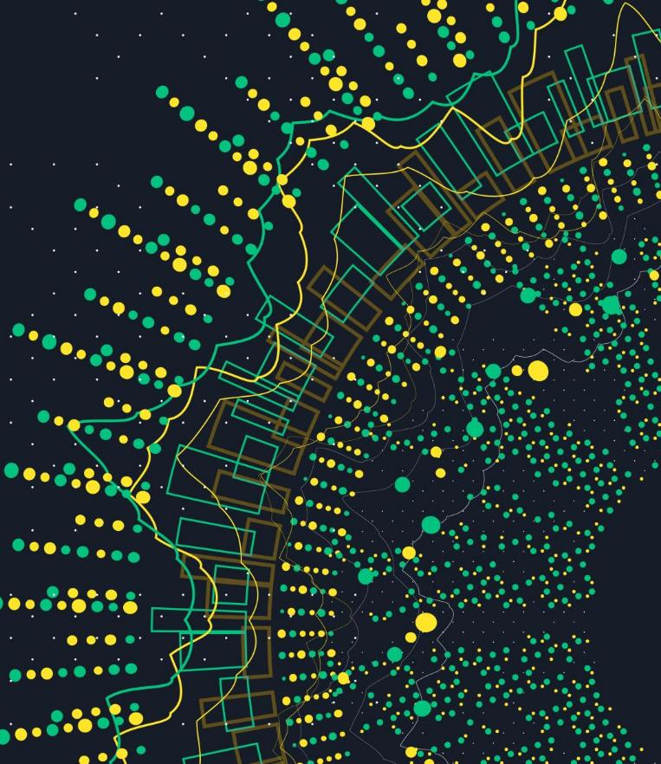

Meme Magic
Aksheetha Muthunooru
Hrudaya Reddy Jinna
Yukta Medha

Slide 2

Brace Yourself!!!!
The Finals are here
We are ready for it!!!!

Slide 3

INTRODUCTION
Memes are cultural phenomenon.
Intersection of image and natural language processing tasks
Different from other types of language modeling tasks - noisy, grammar mistakes, no logic
And it’s fun

Slide 4


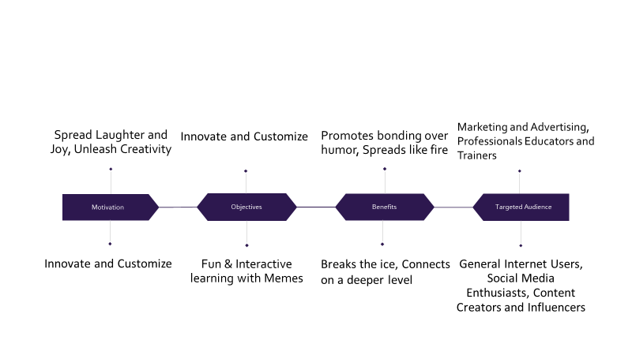

Motivation & Related Services

Slide 5
Research gaps & Goals
Meme Generation
Assumption:
Image inputs
Classical temp meme with no more than 2 captions
Research gaps:
No definite reproduction open source solutions
No satisfactory datasets
Goals:
Test transformer based architecture for image based generation
Collect and release a balanced large scale dataset

Slide 6
Related Works
Dank learning - 3 types of CNN encoders + LSTM decoder with pre-trained GloVe embeddings
Link - Dank learning for Meme Generation
memeBot - Transformer models to meme captions generation
Link - memeBot
Memeify - fine-tuned GPT-2 language model
Link - Memeify

Slide 7
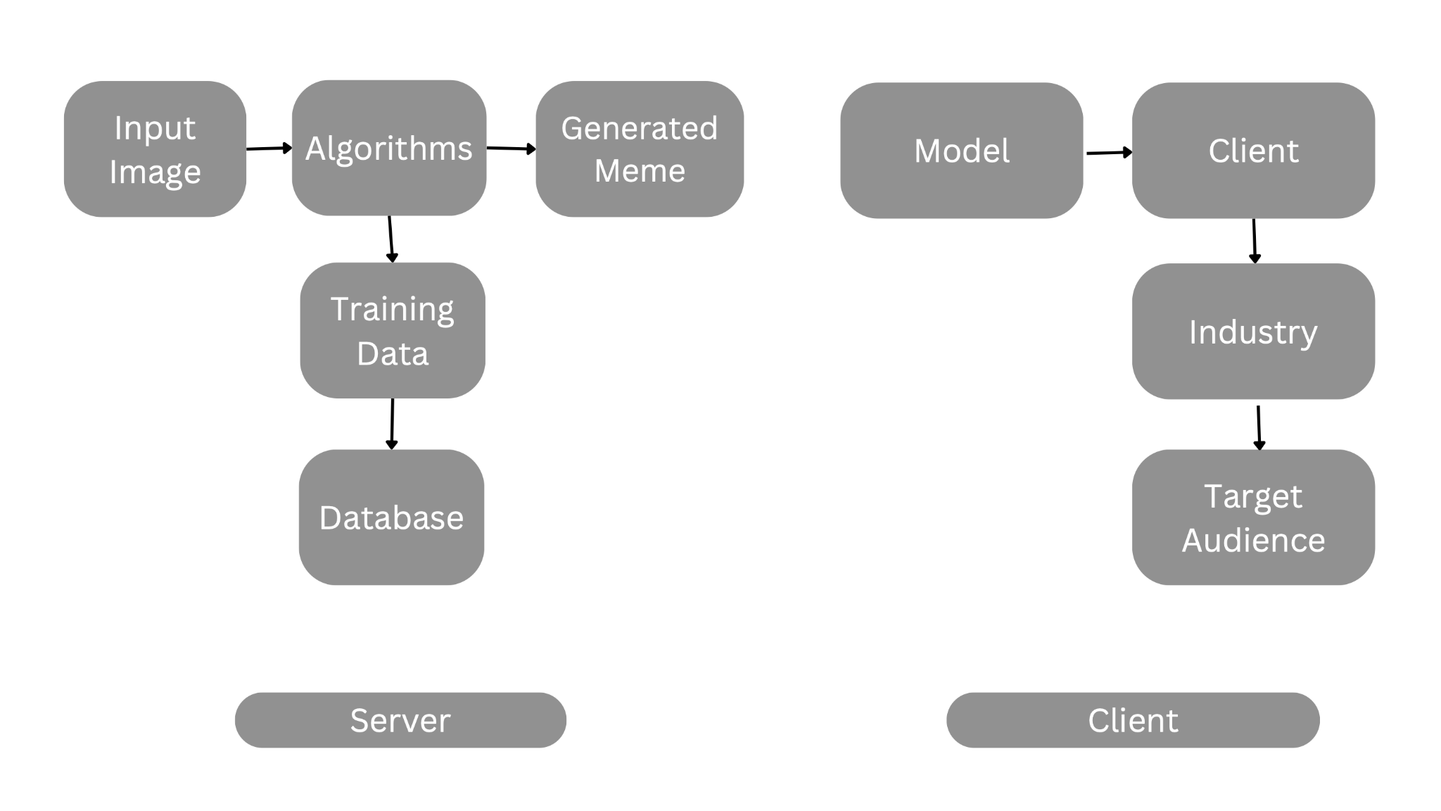
ARCHITECTURE

Slide 8
DATASET_Problems
No standard datasets
Dank Learning(Peirson et al.,2018)-–400k captions
A lot of repeated memes
Presence of outliers
Imbalanced
Memeify(Vyalla et al.,2020) –1.1M captions
Damaged dataset
Absence of the special tokens for text blocks separation
Memebot(Sadasivam et al.,2020)--177k captions
No dataset released

Slide 9
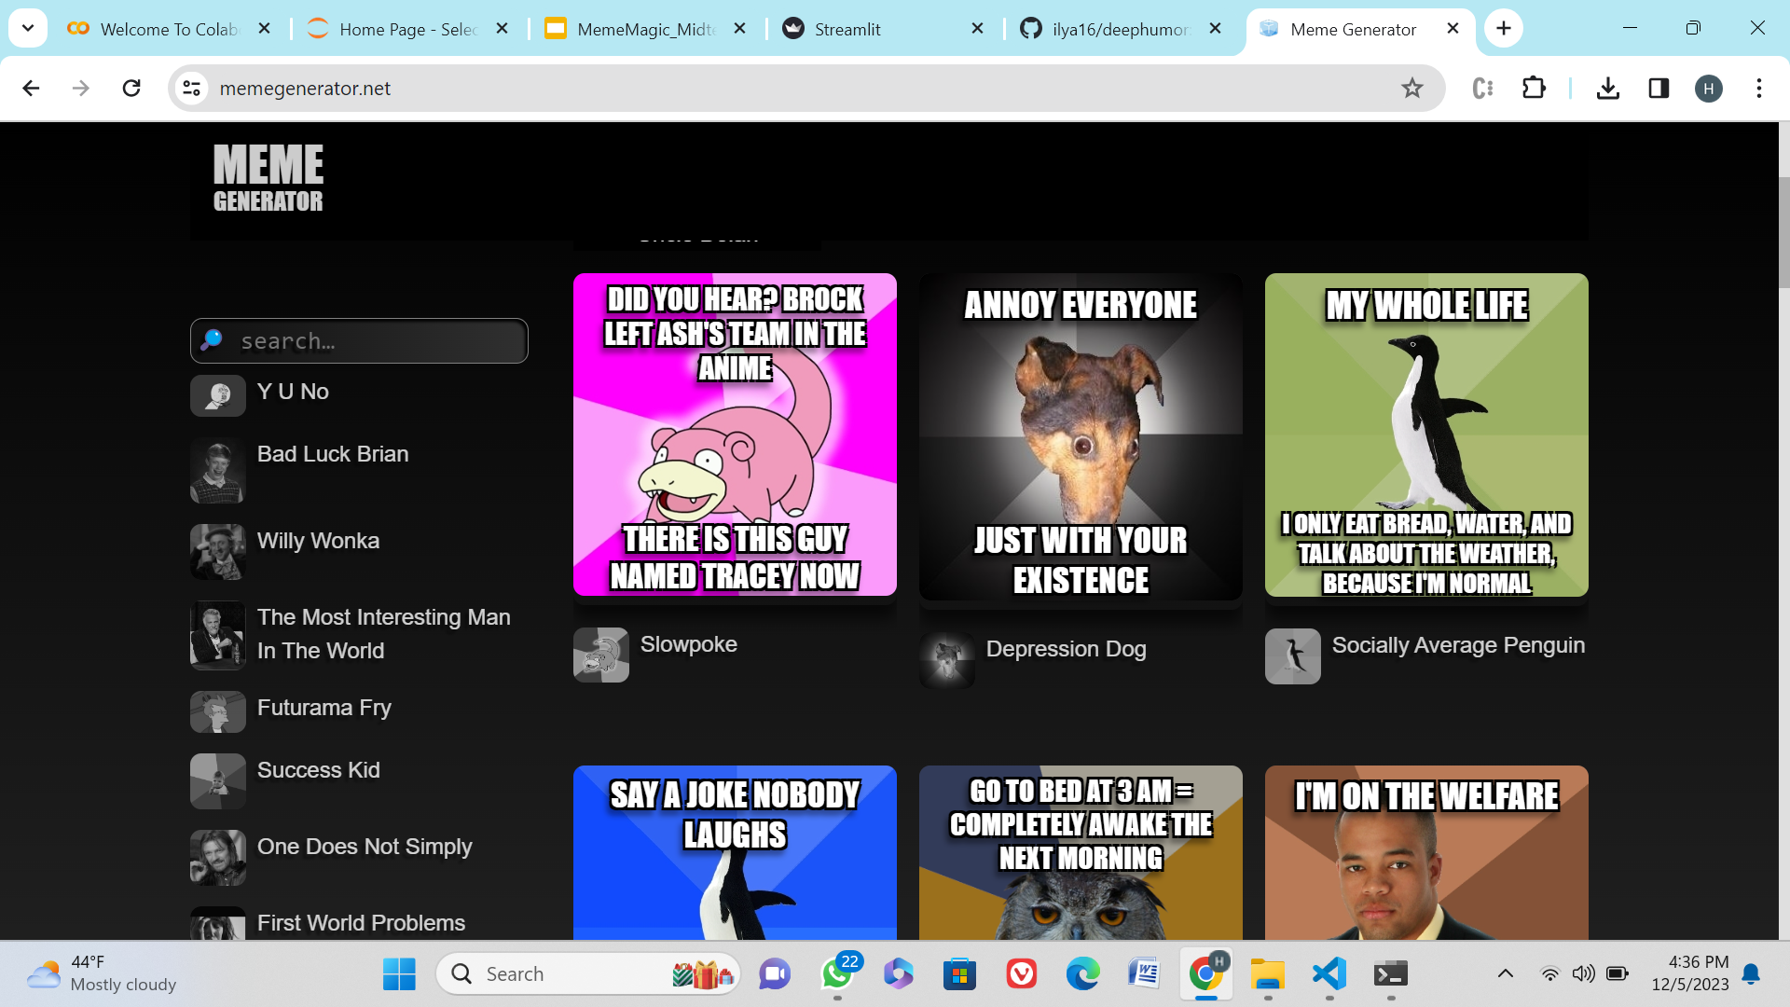
DATASET COLLECTION
Data source: https://memegenerator.net/

Slide 10
Dataset Collection
Cleaning Steps:
Memes without text
captions with non-ASCII symbols;
outliers with <10 or > 100 chars
non-English text
intentional punctuation repetitions
captions with high similarity
Preprocessing:
<SEP> token for text block separation
<EMP> token for empty text blocks

Slide 11
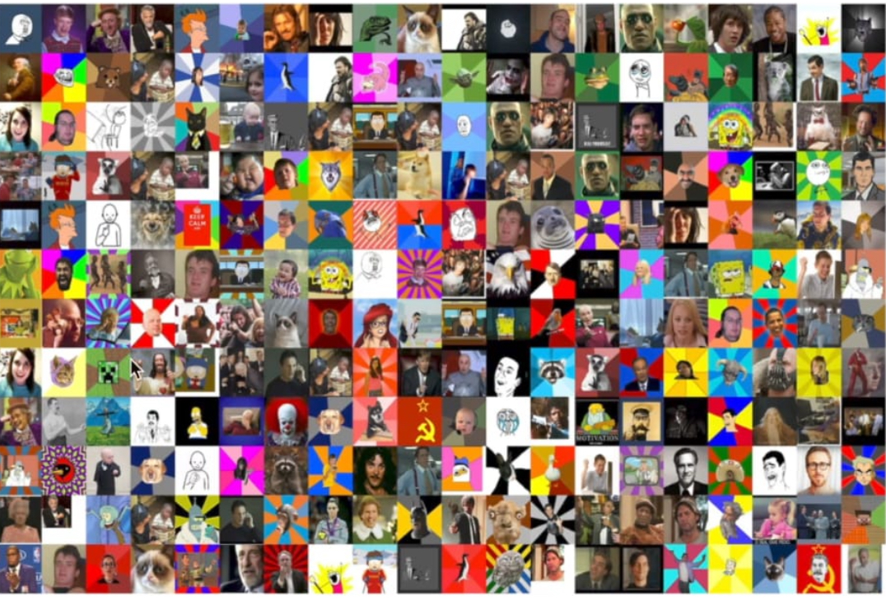
FINAL DATASET
Final Version:
9,00,000 memes
300 meme templates
3000 captions per template
Data Splits
Train/Val/Test sets
2500/250/250 captions/template

Slide 12
Models
Encoders
Image only
image label similar to Dank Learning
(New) image only with spatial features
Decoders
CNN,LSTM
(New)Base Transformer - only global image features
(New)Transformer- global + spatial encoder features

Slide 13
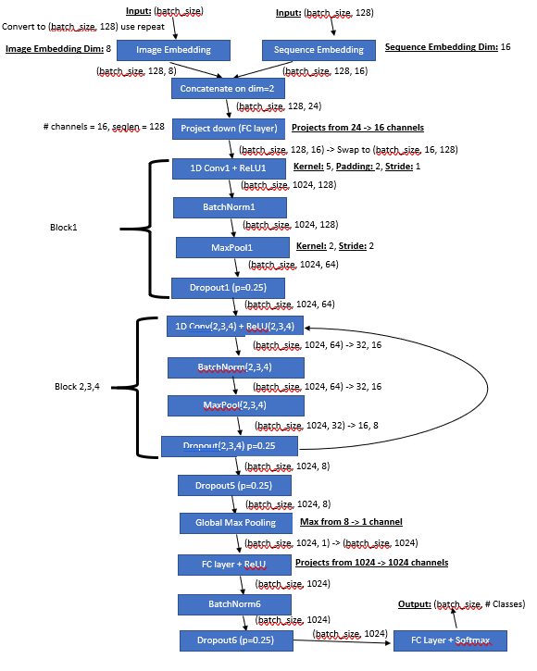
MODEL 1 - CNN
Inputs: Img_Index (batch_size), Input _Sequence (batch_size, 128)
Outputs: Probabilities of next character (batch_size)
Loss: Cross Entropy Loss
Metrics: Validation Accuracy
Description
Character Embeddings combined with Image Embeddings
Use 1D Convolution, ReLU, Max Pooling, BatchNorm, Dropout
Similar to CNN for Image Classification

Slide 14
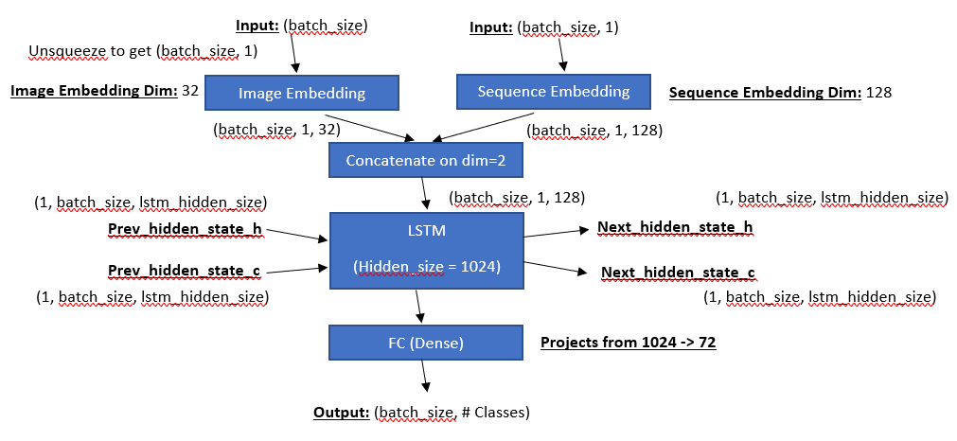
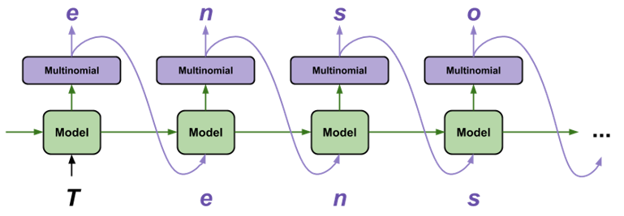
MODEL 2 - LSTM
Long-Short Term Memory
Inputs: Img_Index (batch_size), Input _Sequence (batch_size, 128)
Outputs: Probabilities of next character (batch_size)
Loss: Cross Entropy Loss
Metrics: Validation Accuracy
Description
Character Embeddings combined with Image Embeddings
Simple LSTM network
Training takes actual label, Evaluation takes previous predicted output
https://www.tensorflow.org/tutorials/text/text_generation

Slide 15
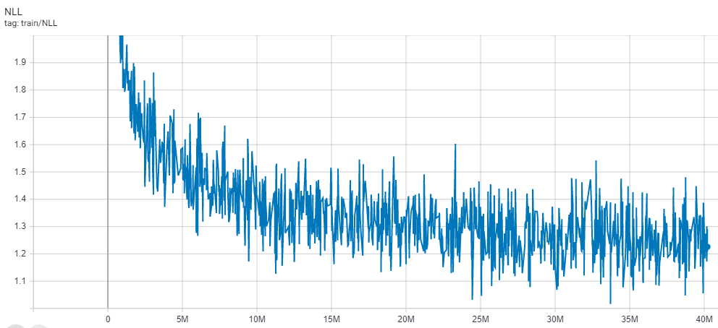
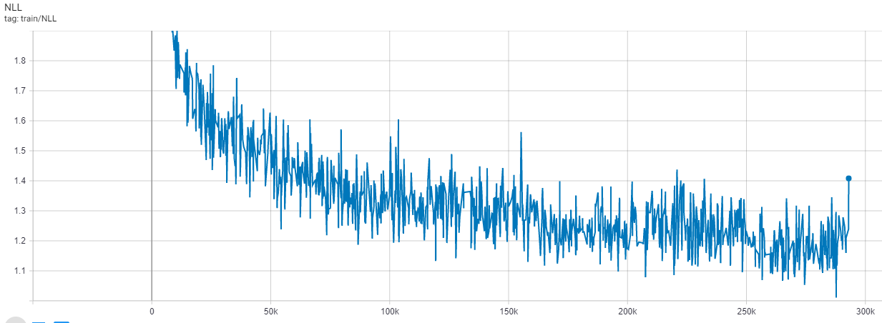
MODEL RESULTS
Model1 - CNN
Model2 - LSTM
Step | Val Loss | Val Acc |  | Step | Val Loss | Val Acc |  | Step | Val Loss | Val Acc
2M | Large | 50.65% |  | 16M | 1.26 | 61.53% |  | 30M | 1.21 | 63.03%
4M | 1.46 | 56.27% |  | 18M | 1.35 | 61.75% |  | 32M | 1.21 | 63.12%
6M | 1.38 | 58.34% |  | 20M | 1.24 | 62.02% |  | 34M | 1.20 | 63.26%
8M | 1.35 | 59.38% |  | 22M | 1.24 | 62.26% |  | 36M | 1.20 | 63.31%
10M | 1.32 | 60.16% |  | 24M | 1.23 | 62.48% |  | 38M | 1.20 | 63.42%
12M | 1.29 | 60.71% |  | 26M | 1.25 | 62.66% |  | 40M | 1.19 | 63.61%
14M | 1.46 | 60.89% |  | 28M | 1.22 | 62.83%
Step | Val Loss | Val Acc |  | Step | Val Loss | Val Acc |  | Step | Val Loss | Val Acc
30k | 1.52 | 55.28% |  | 120k | 1.29 | 61.46% |  | 210k | 1.24 | 62.91%
60k | 1.39 | 58.97% |  | 150k | 1.27 | 62.14% |  | 240k | 1.23 | 63.13%
90k | 1.33 | 60.49% |  | 180k | 1.25 | 62.57% |  | 270k | 1.20 | 63.35%
All models was trained for 8 hours (8 epochs for CNN, 4 epochs for LSTM)
Evaluated every 2M samples for CNN and 90k samples for LSTM

Slide 16
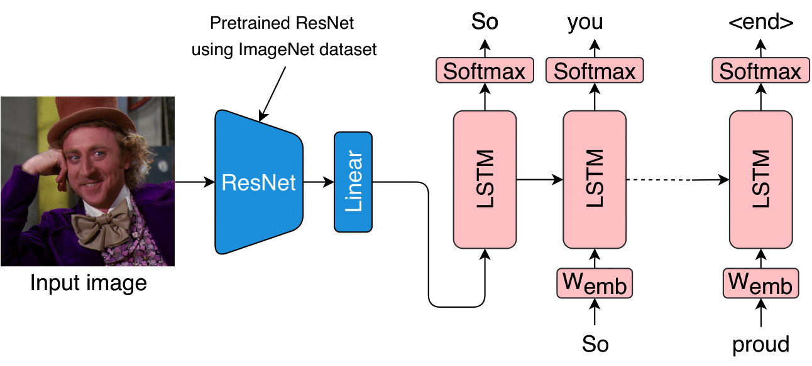
Captioning LSTM model (Image-only Encoder)
Encoder - Image only —------> Pre-trained on ImageNet, ResNet-50
Decoder - Multi-layer LSTM —-----> Learned Word Embeddings —-> Training using teacher forcing - Inference - step by step predictions

Slide 17
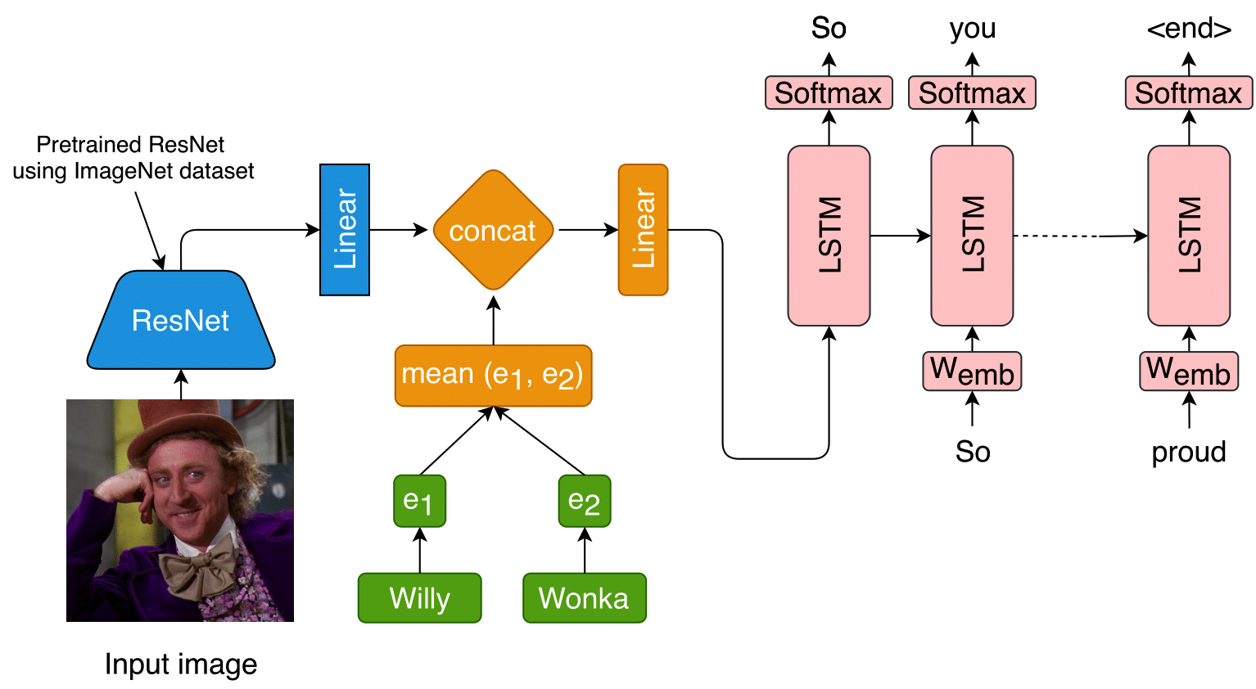
Captioning LSTM model (Image-label encoder)
Encoder - Image only + meme text label —--> Concatenate image and average label embeddings fed through a Linear layer
Decoder - Multi - Layer LSTM —---> the same as in previous case

Slide 18
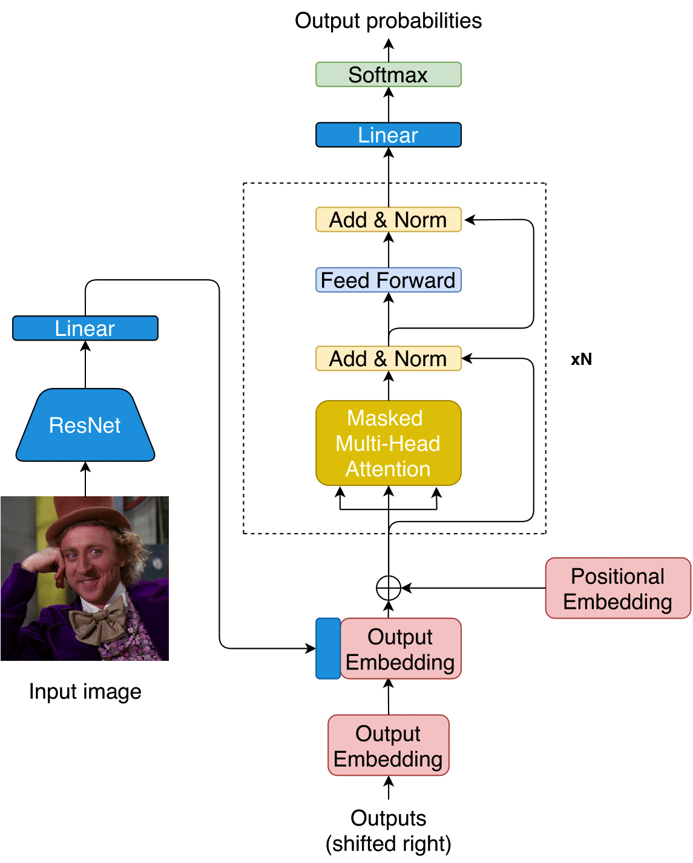
Base Captioning Transformer
Encoder - Image-only Encoder —--> ResNet-50
Decoder - Modified vanilla transformer decoder,
Image embedding is prepended to shifted outputs as
the start token.
Masked multi-head attention and position-wise
feedforward blocks.

Slide 19
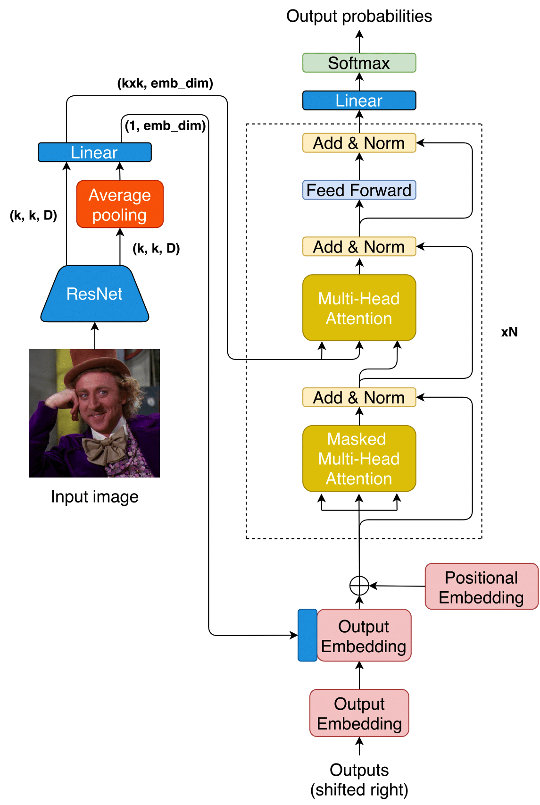
Captioning Transformer with
Spatial Features
Encoder - Global Image Embeddings + kxk spatial features as output
Decoder - Vanilla Transformer decoder
Inspired by captioning transformer model
Global image embedding is prepended to shifted outputs as
the start token.
Spatial image features go through multi-head attention layers.

Slide 20
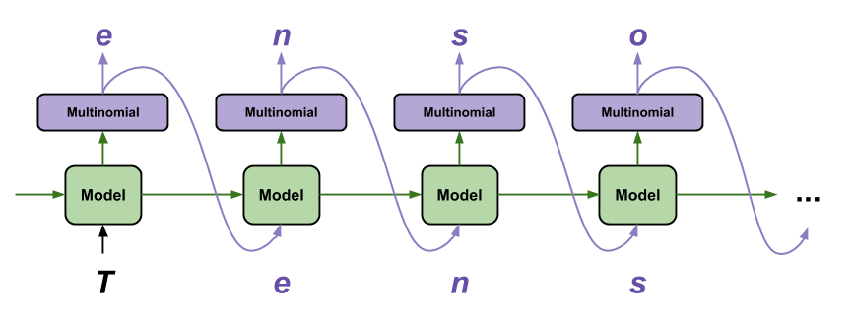
PREDICTION/INFERENCE
Add <start> token initially + any other characters supplied
Feed into network and get one next character -> Generate text until <end> is reached
Methodology:
Greedy -> Same result every time!
Sampling -> Varying Result based on probabilities
Beam Search -> Select most probable output considering search on (k=3) timesteps
https://www.tensorflow.org/tutorials/text/text_generation

Slide 21
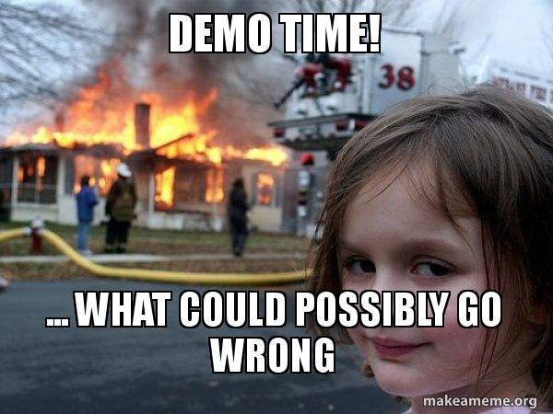

Slide 22

GUESS?

Slide 23






TOOLS
Python
Tensorflow
Pytorch
Google Colab
ReactJS
Streamlit

Slide 24
EXPERIMENTS
Main Goals:
-Transformer based models vs. LSTM based models
- Effect of text labels on LSTM based models
-Word-level vs. Character level tokenizations
Hyperparameters | Dataset | Training
Same hyperparameters for models Embedding and hidden sizes: 512 Number of layers: 3 Encoder dropout: 0.3 | Meme templates: 200 Captions: Training: 500,000 Validation: 50,000 Test: 50,000 LSTM with labels: 200 text meme labels. | Adam optimizer lr = 2e-4 (word-based) lr = 5e-4 (chars-based) scheduler with y = 0.95 Cross-entropy loss Number of epochs: 10 Batch size: 128 Training Iterations:40,000

Slide 25
RESULTS
LSTM-based models are much better than Transformer-based
Image only and image label LSTM models are quite similar
Base Transformer performed better than one with spatial features.

Slide 26

Work done by……
Frontend - Hrudaya Reddy
Backend - Aksheetha Muthunooru
Data preprocessing & visualization - Yukta Medha

Slide 27
CONCLUSION/FUTURE WORK
LSTM performed better
Coherent captions can be generated
Human generated memes are still better!
Make more accurate memes with different set of models

Slide 28
REFERENCES
1.Peirson V, A. L., & Tolunay, E. M. (2018). Dank Learning: Generating Memes Using Deep Neural Networks. ArXiv. /abs/1806.04510
2. Sadasivam, Aadhavan & Gunasekar, Kausic & Davulcu, Hasan & Yang, Yezhou. (2020). memeBot: Towards Automatic Image Meme Generation.
3. Vella SA, Swann C, Batterham M, Boydell KM, Eckermann S, Ferguson H, Fogarty A, Hurley D, Liddle SK, Lonsdale C, Miller A, Noetel M, Okely AD, Sanders T, Schweickle MJ, Telenta J, Deane FP. An Intervention for Mental Health Literacy and Resilience in Organized Sports. Med Sci Sports Exerc. 2021 Jan;53(1):139-149. doi: 10.1249/MSS.0000000000002433. PMID: 32555025; PMCID: PMC7737879
4. https://github.com/schesa/ImgFlip575K_Dataset.
5.https://towardsdatascience.com/meme-text-generation-with-a-deep-convolutional-network-in-keras-tensorflow-a57c6f218e85

Slide 29


